Slide 1
Numerical Studies on Four-engine Rocket Exhaust Plume Impinging on Flame Deflectors with Afterburning
Zhi-tan Zhou et al., Defence Technology, Vol.17, pp.1207-1216, 2021
2023.10.31
김진성

Slide 2
Table of Contents
Introduction
Four-engine rocket model
Numerical method
Model validation
Result and discussion
Conclusion

Slide 3
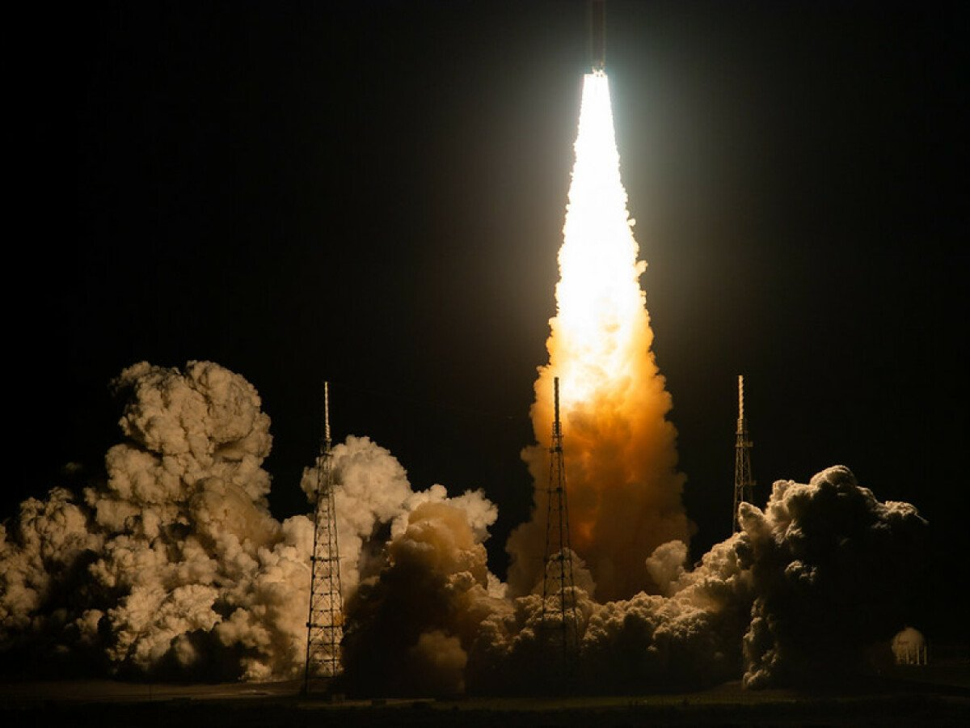
Introduction
To explore the further deep space, many countries are developing new generation launch vehicles with more effective loads.
To achieve a large carrying capacity, the propulsion systems usually use multiple engines working simultaneously to improve the launch power.
The multi-engine rocket have certain advantages but the impingement flow field is more complex which caused by the exhaust plume interaction.
Since the rocket engines are close to the launch platform during launching phase, the exhaust jets of rocket engine not only disturb the attitude of rocket in the take-off, but also have a thermal impact on the rocket base and ground control system.

Slide 4
Introduction
To reduce the effect of thermal shock and dynamic of the rocket jet flow, flame deflectors have been installed under the rocket engine to guide the exhaust gas of high temperature and velocity away from the channel without recirculation.
The accumulation and reflection of the high temperature gas have a negative influence on the stability of the flame deflector and security of the launch process.
Using the reasonable shape of the flame deflector can reduce the adverse effects caused by the recirculation or backdraft of rocket exhaust gas.
Therefore, the get flow characteristics of multi-engine rockets exhaust plume need to be studies carefully for the risk aversion and improvement of achievement ratio in launching.

Slide 5
Introduction
Previous study
Daniel and Vineet obtained the structure of the ARES V exhaust jet flow and its impingement characteristics on the B-2 flame deflector by using a multi-element flow solver.
Sachdev et al. investigated the temperature load on the flame deflector by numerical simulations.
Tsutsumi et al. developed a universal performance assessment and control system-large eddy simulation computational code to study the effect of deflector shape on the plate and the tail shock waves.
Jiang et al. presented an overview on progresses and perspectives of the jet impingement research for rocket launching.
In this study
Studies the influences of two shapes of flame deflector configurations which are designed for the four-engine liquid rockets.
A comparison of the rocket motor exhaust jet impingement on the different deflectors can reflect the variation of flow field and provides reference for designs of the launch platforms.

Slide 6
Table of Contents
Introduction
Four-engine rocket model
Numerical method
Model validation
Result and discussion
Conclusion

Slide 7
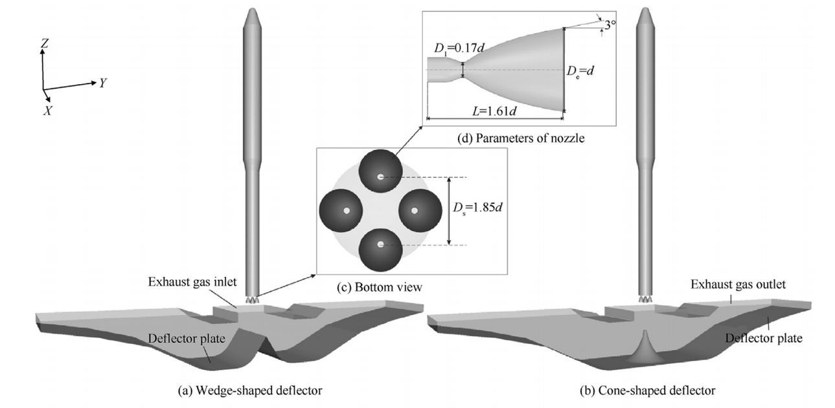
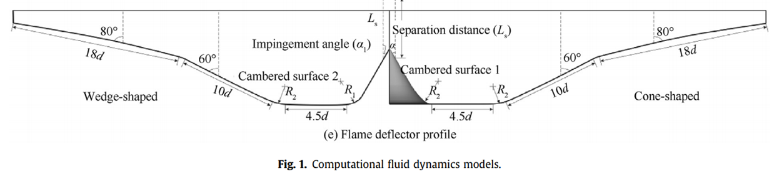
Four-engine rocket model
Geometric model of the platform

Slide 8
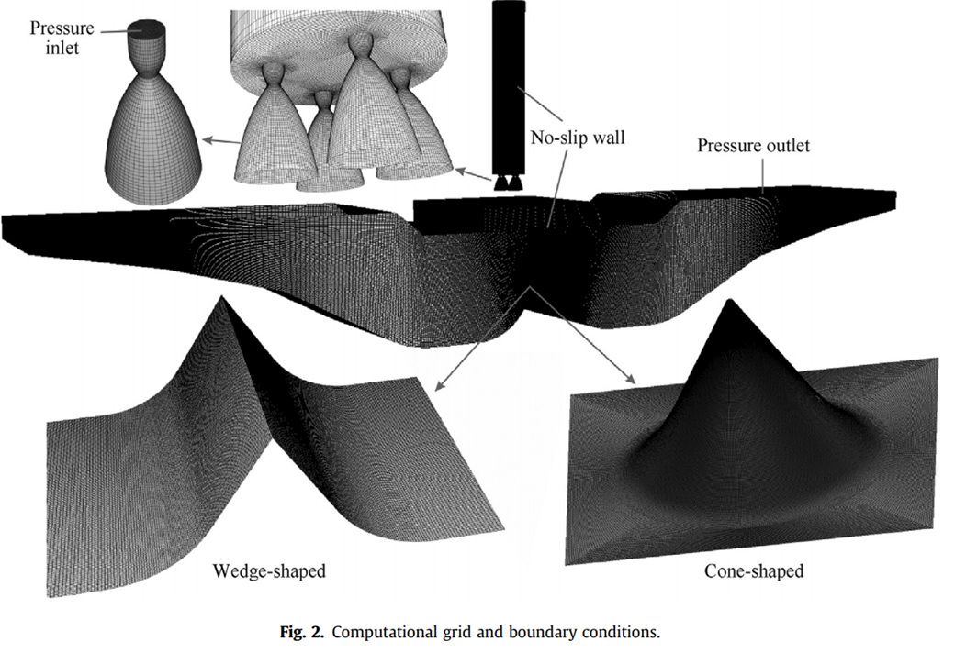
Four-engine rocket model
Computational grids
No-slip adiabatic temperature condition is applied for the solid walls of the rocket and deflectors.
The inlet condition is set as the total temperature 3800K and total pressure 18.66MPa.
The species mole fraction of exhaust gas at inlet are given in Table 1.
Table 1. The composition and content of exhaust gas at the nozzle inlet
Component | H₂0 | CO₂ | CO | H₂ | Air
Mole fraction | 0.39 | 0.26 | 0.25 | 0.09 | 0.01

Slide 9
Table of Contents
Introduction
Four-engine rocket model
Numerical method
Model validation
Result and discussion
Conclusion

Slide 10
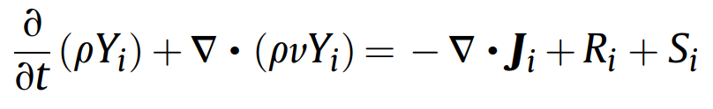
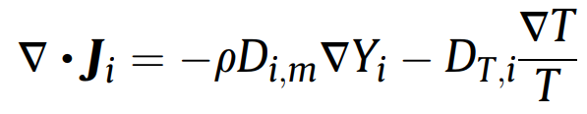
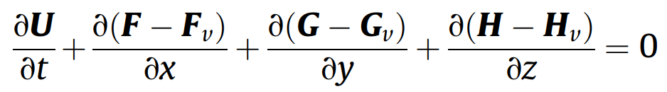
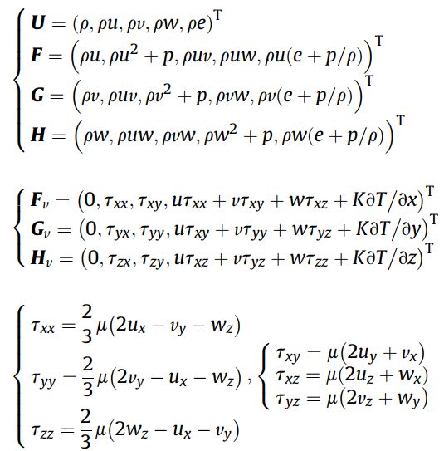
Numerical method
Governing equations
ρ : fluid density
Y_{i} : the local mass fraction of species i
S_{i} : rate of creation
J_{i} : the diffusion flux
U : the flow variables
F, G, H : the flow flux vectors
F_{v} , G_{v} , H_{v} : the viscous flux vectors
The multi-component conservation equation
The mass, momentum, and energy conservation

Slide 11
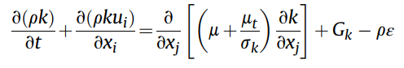
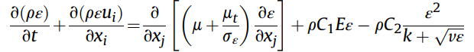
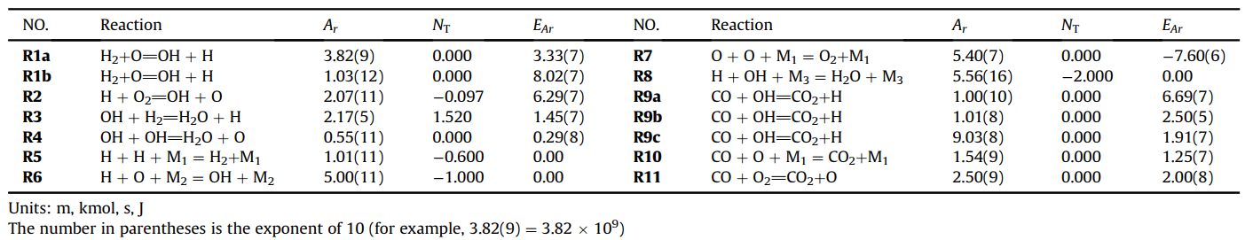
Numerical method
Turbulence model
Realizable k-ε turbulence model
Reaction model
The 9-species and 14-step chemical mechanism

Slide 12
Table of Contents
Introduction
Four-engine rocket model
Numerical method
Model validation
Result and discussion
Conclusion

Slide 13
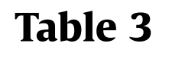
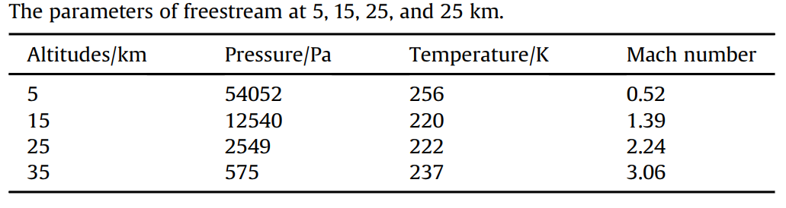
Model validation
The Mach number contours on the symmetry plane at different flight altitudes are obtained by numerical method described above.
The conditions of freestream at different altitudes are shown in Table. 3.
The total pressure and temperature in the chamber are 18.66MPa and 3800K.

Slide 14
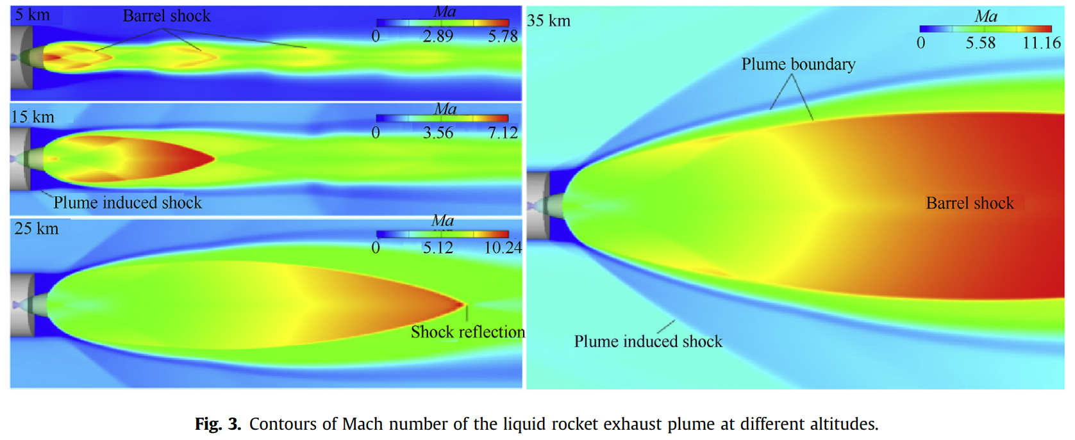
Model validation
As the elevation gradually increases, the ambient pressure decreases, the Mach number increases, and under-expanded plume becomes larger.
The shock reflection gradually moves away from the nozzle.

Slide 15
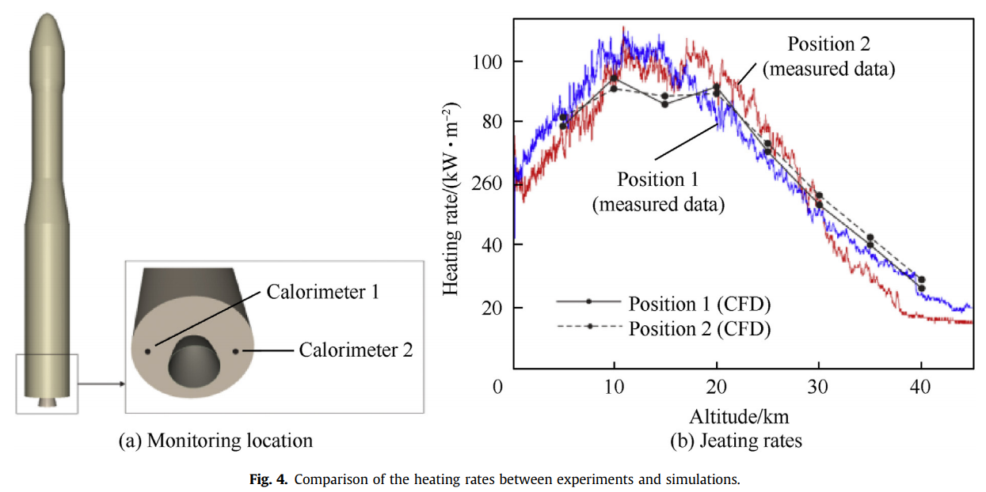
Model validation
Fig.4 shows the simulated and the measured heating rates at two calorimeters in the rocket base.
The heat flux has two peaks with the maximum values at approximately 10 and 20km.
The simulated results are slightly different with the measured data, since governing equations of the model are discretized by using second-order TVD scheme rather than higher than order method.

Slide 16
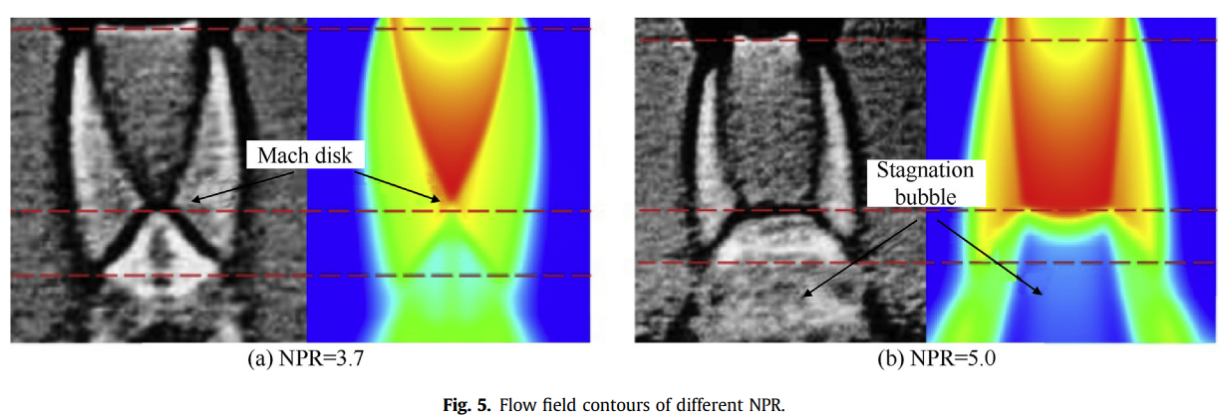
Model validation
Fig. 5 shows the flow field structure of Ref.[1] (left) and numerical result (right) with different nozzle pressure ratio (NPR) when the distance (h) between the ground plate and the nozzle exit is equal to 2D(exit diameter).
The contours from numerical simulations are similar to the flow stricture in the experiments.
[1] Alvi F, Iyer K. Mean and unsteady ﬂowﬁeld properties of supersonic impinging jets with lift plates 5th AIAA/CEAS Aeroacoustics Conf. 1999.

Slide 17
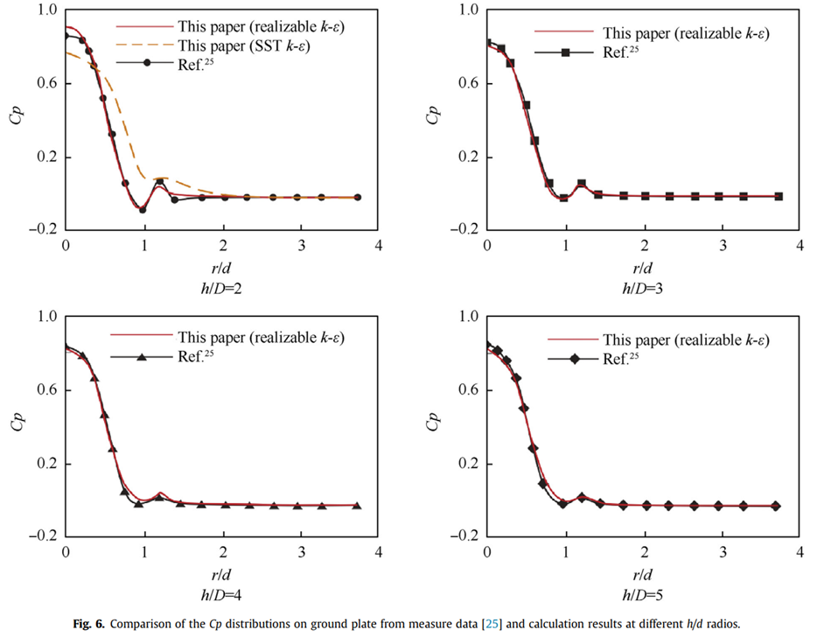
Model validation
For the NPR is 3.7, the surface pressure coefficient (Cp) distributions with the change of the radial location (r/D) at h/D=2 to 5 are shown in Fig. 6

Slide 18
Table of Contents
Introduction
Four-engine rocket model
Numerical method
Model validation
Result and discussion
Conclusion

Slide 19
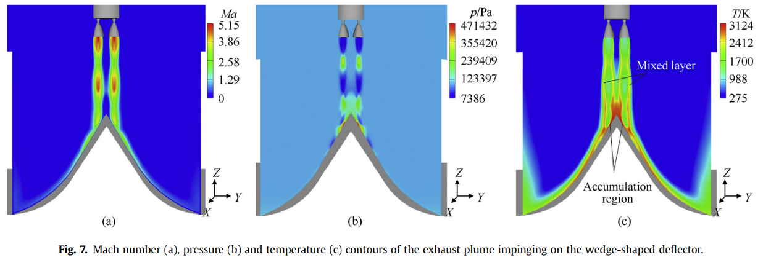
Results and discussion
The exhaust plume flow field (1/3)
The Mach number, pressure, and temperature contours of the four-engine rockets exhaust plume impinging on the wedge-shaped and cone-shaped deflectors are shown in Figs. 7 and 8.
Under the combined effect of external air and high unexpanded exhaust gas, a clear structure of the first shock cell can be observed near the rocket gas field.
Second shock cell-like structure is less clear due to the interaction of the four equal plumes.

Slide 20
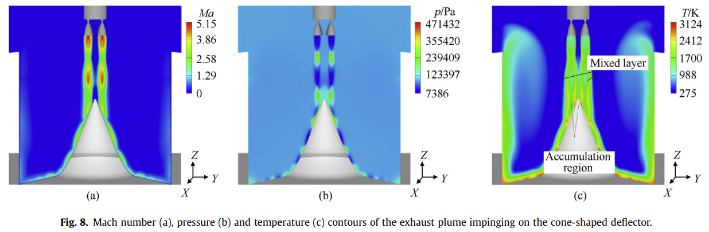
Results and discussion
The exhaust plume flow field (2/3)
The Third shock cell deforms after the engine exhaust plumes impact the deflector surface.
A high temperature region is generated immediately on the deflector surface due to the impingement and accumulation of excessive high temperature gas.
Due to the afterburning reaction between exhaust gas and air, high temperature also occurs in the mixed layer and average slightly below accumulation region temperature.

Slide 21
Results and discussion
The exhaust plume flow field (3/3)
Due to the restriction of the sidewall of the cone-shaped deﬂector, part of exhaust gas exits the deﬂector channel through inlet rather than outlet.
Improvements to the cone-shaped deﬂector design are useful for deﬂecting exhaust gas smoothly.
As the spacing of the sidewalls increases, the cone-shaped deﬂector could prevent damage to the rocket due to the reverse exhaust plumes.

Slide 22
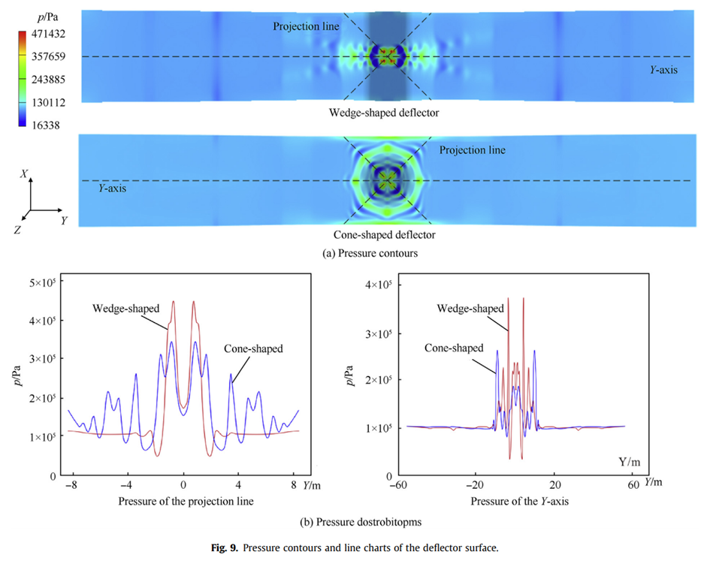
Results and discussion
The impingement surface flow field – pressure distrubution
The region of peak pressure appears under the rocket nozzle, which is the result of the direct impact of exhaust plume.
The wedge-shaped defelctor has a peak pressure of 471.4kPa in impingement point, well above the 343.5kPa in the same position on the cone-shaped deflector.
As the conical surface has bigger impact area and better ﬂow capacity, the pressure in the projection line of the wedge surface is higher than those on the conical surface, with the biggest difference about 37.2% at the impingement point.

Slide 23
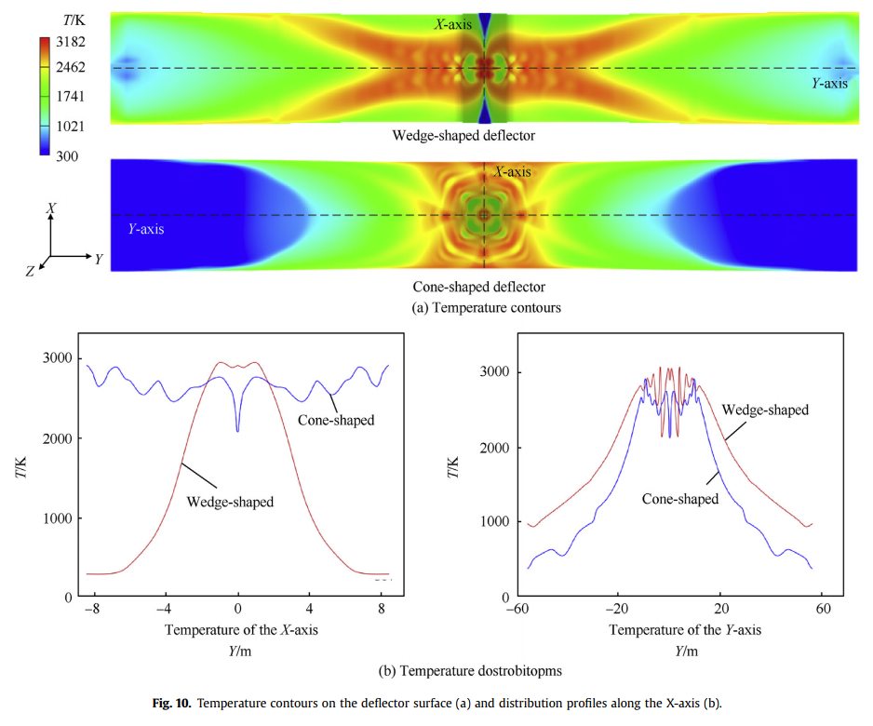
Results and discussion
The impingement surface flow field – temperature distribution
A larger high-temperature region appears in the wedge-shaped deflector.
Different diversion orientation of the flame deflectors is a prime cause of the difference in temperature distribution.
- The supersonic exhaust plume was diverted into outlet with two directions in the wedge-shaped deflector.
- The cone-shaped deflector can deflect the exhaust gas towards the circumferential direction, which will cause a smaller thermal shock effect.
The high temperature region on the wedge surface is much higher and more focused than in the conical surface, which will more easily lead to a significant ablation and damage in the wedge-shaped deflector.

Slide 24
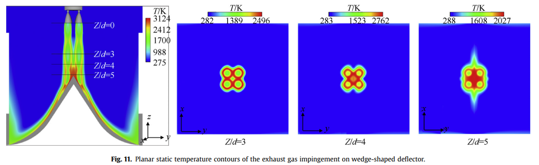
Results and discussion
Planar static temperature contour – wedge-shaped deflector
The influence of the plume interaction and exhaust gas circulation are weak since the relatively stable individual shock unit can be observed at Z/d=3 and 4.
The planar static temperature contour at Z/d = 5 is blurred and a circular high temperature region is occurred in the core, which mainly caused by the interaction between exhaust and reverse ﬂow.
The exhaust gas inlet of the wedge-shaped deﬂector has the same temperature as atmosphere except for jet ﬂow region, and not affected by the reverse ﬂow.

Slide 25
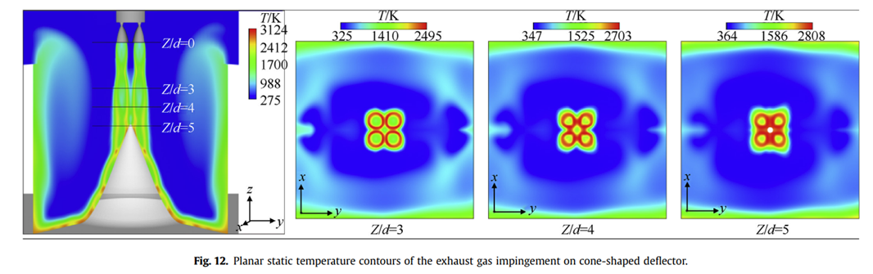
Results and discussion
Planar static temperature contour – cone-shaped deflector
A part of gas flow is discharged from the exhaust gas inlet due to the resistance in sidewalls.
The temperature in edge region of planar, as wall as the central region, is much higher than ambient temperature.
Increasing the distance between the sidewalls of the cone-shaped deflector could be helpful to prevent the damage of the rocket afterbody from high temperature reverse flow.

Slide 26
Table of Contents
Introduction
Four-engine rocket model
Numerical method
Model validation
Result and discussion
Conclusion

Slide 27
Conclusion
Numerical simulations have been performed to investigate the exhaust gas impinging on the wedge-shaped and cone-shaped deﬂectors.
By comparative analysis between the four-engine rockets impinging jet on different deﬂector, the following conclusions can be made:
The peak pressure on the deflector surface appears at the intersection of the nozzle axis and the deflector plate, and the temperature drops gradually from the center to the outlet of the deflector.
The wedge-shaped and cone-shaped deflectors have different diversion directions. The maximum pressure and temperature in the wedge-shaped deflector are, respectively, 37.2% and 9.9% higher than those in the cone-shaped flame deflector.
Compared to the wedge-shaped deflector, the cone-shaped deflector could achieve better performance for deflecting with sufficient distance of the sidewalls.

Slide 28
Thank you

